Slide 1
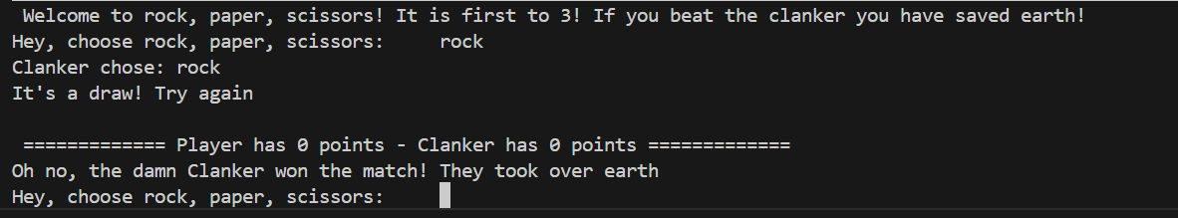
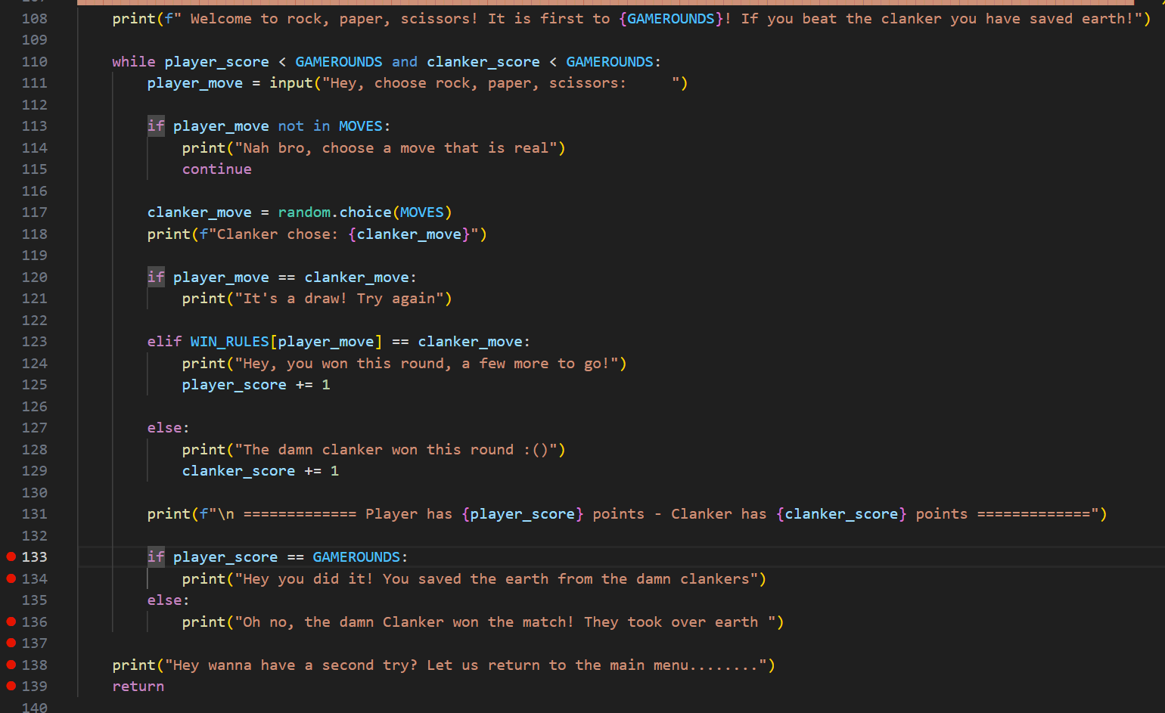
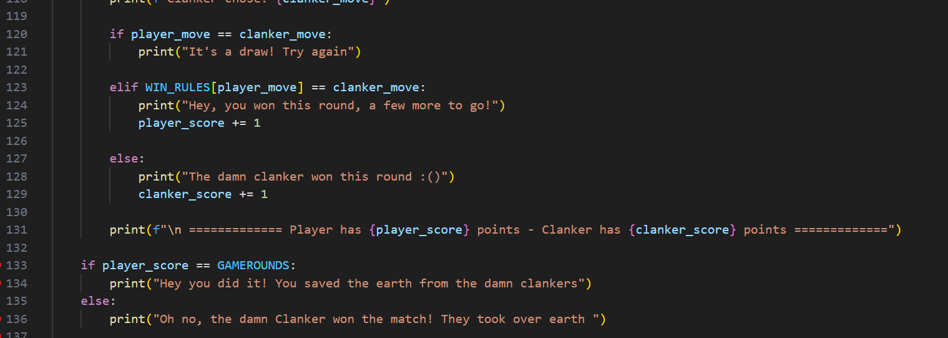
Shows that terminalwon even though game hasn’t finished
Version: 3
Date: 5/03/26
GitHub Commit: 2nd commit
Error | Code (Broken)
- I already knew that it was part of the rps_game() function as I only tested out rps_function() on its own due to not starting the main loop yet Not any problem that vs code is detecting, due to not being a logic or any error Something to do with lines between 133 and 138
Fix:
The error was that it was part of the main loop, which means that instead of happening at the end of the match, the clanker was already winning due to player_score not being equal to GAMEROUNDS and the else statement in line 135 was already being triggered.
The fix was an indentation error that vs code didn’t detect, and was just a visual bug, the fix was to move lines 133-136 to the second indentation closest to the margin

Slide 2
Invalid syntax
Version: 5
Date: 5/03/26
GitHub Commit: after 2nd commit
Error | Code (Broken)
Not visible(not error)) The error is invalid syntax due to it being an input message and not a print message
Fix:
Since it was an input message the ‘:’ is not required so by removing it fixes the issue

Slide 3
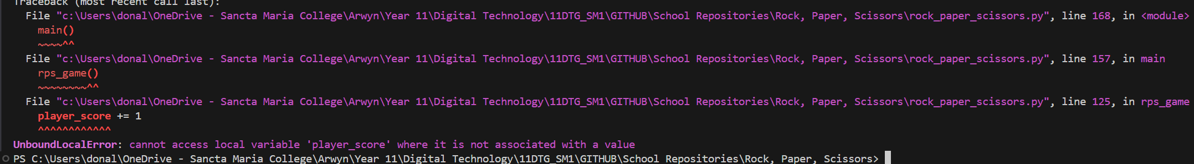
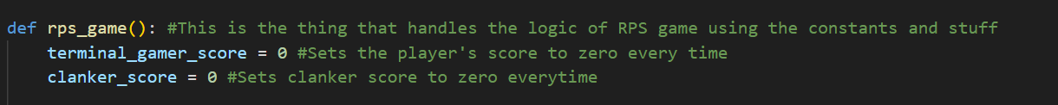
Variable issue
Version:
Date: 6/03/26
GitHub Commit: after 4th commit
Error | Code (Broken)
Unbound local error: cannot access local variable ‘player_score’ where it is not associated with a value
Fix:
Since I changed the name of the variable “player_score” the logic gets confused. Changed the name of the player_score variable to terminal_gamer_score since it was the actual variable name

Slide 4
Variable issue
Version:
Date: 6/03/26
GitHub Commit: after 4th commit
Error | Code (Broken)
Unbound local error: cannot access local variable ‘player_score’ where it is not associated with a value
Fix:
Since I changed the name of the variable “player_score” the logic gets confused. Changed the name of the player_score variable to terminal_gamer_score since it was the actual variable name

Slide 5
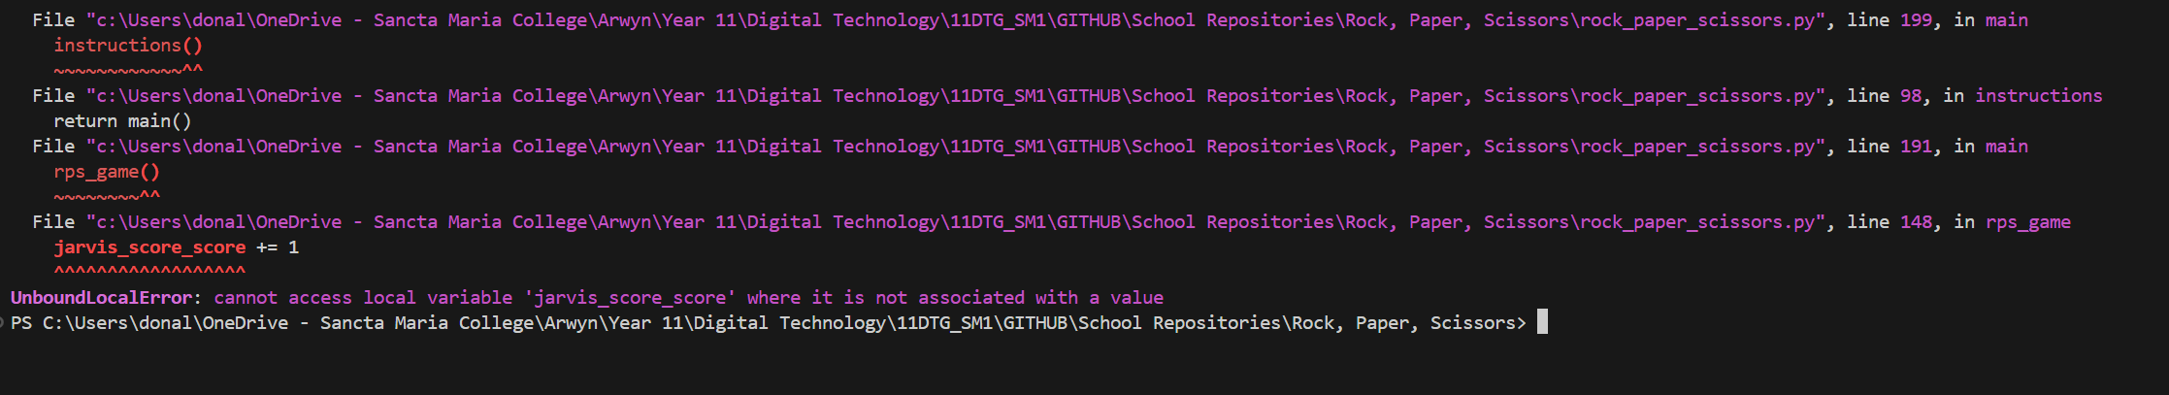
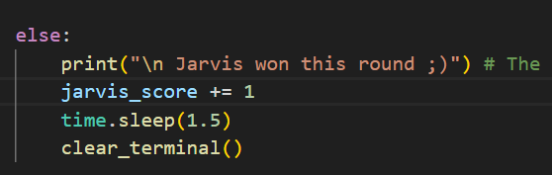
Variable issue
Version: 11
Date: 7/03/26
GitHub Commit: after 14th commit
Error | Code (Broken)
Unbound local error: cannot access local variable ‘jarvis_score_score’ where it is not associated with a value
Fix:
Deleted the second “_score” part of the variable being changed. Since the original variable is just jarivs_score

Slide 6
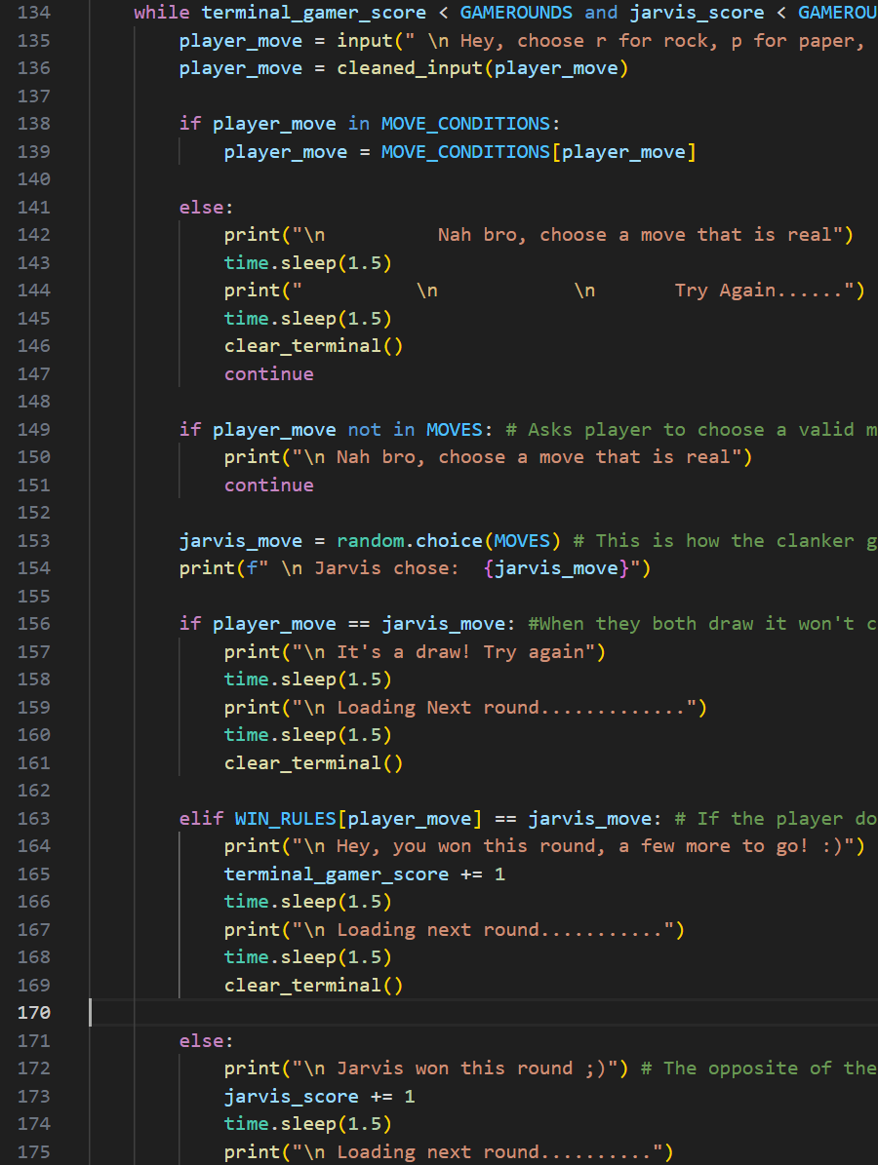
RPS – can’t type rock, paper, or scissors as valid move
Version: 11
Date: 7/03/26
GitHub Commit: after 14th commit
Error | Code (Broken)
Doesn’t register ‘rock’, ‘paper’, or ‘scissors’ as a valid move and prompts the user to pick a valid move like (‘r’, ‘p’, ‘s’)
Fix:
In MOVE_CONDITIONS constant, I added (e.g. “rock”: ROCK) and repeated that for scissors and paper

